Slide 1
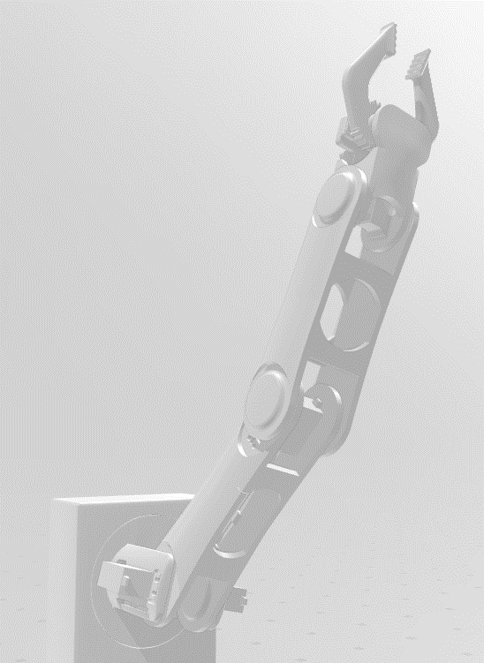
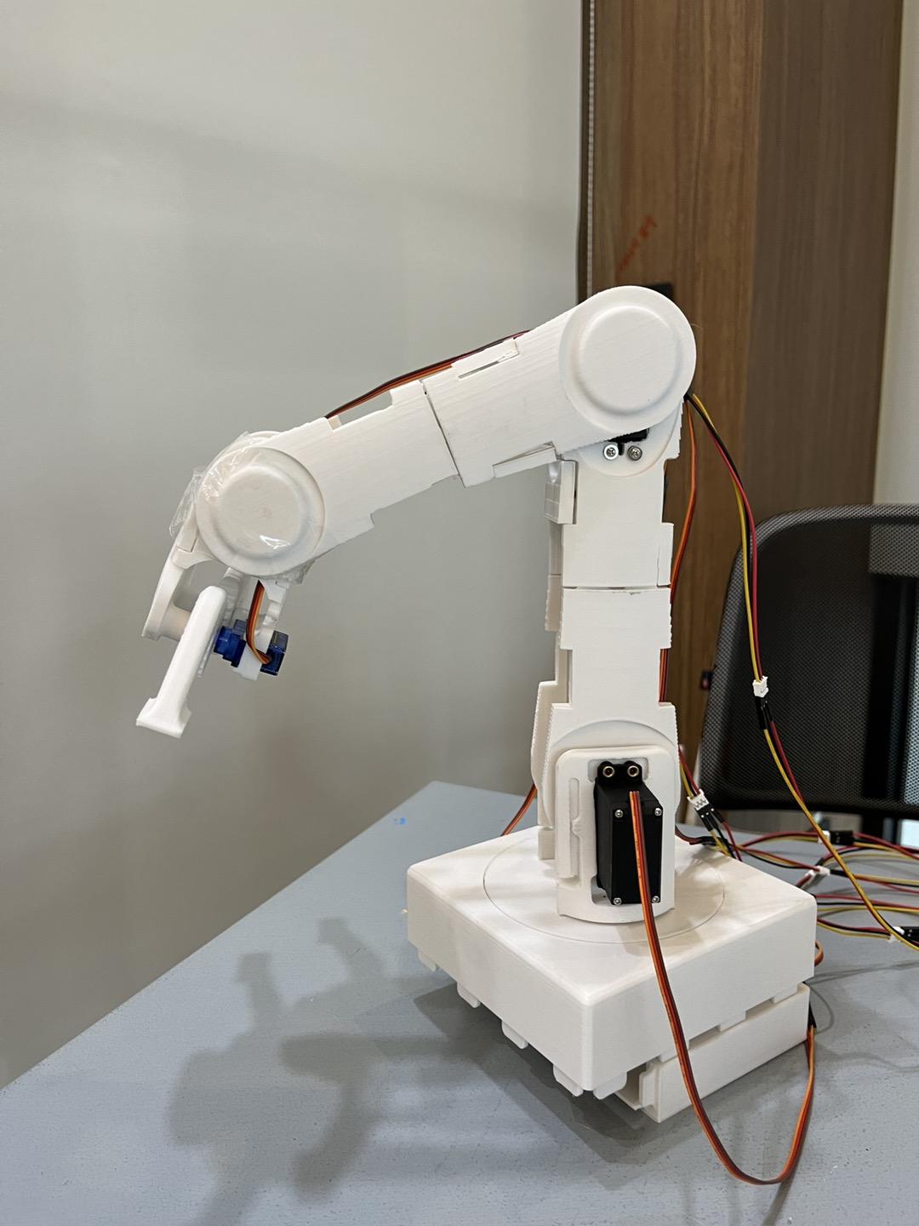
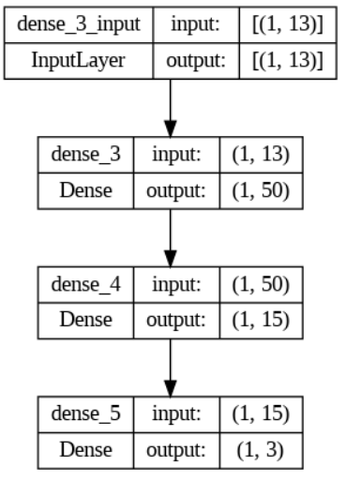
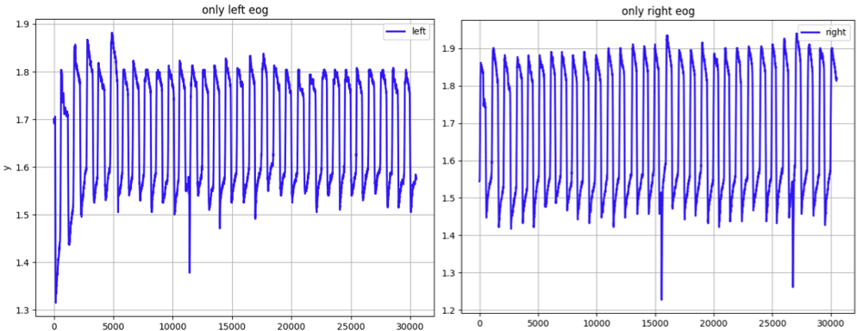
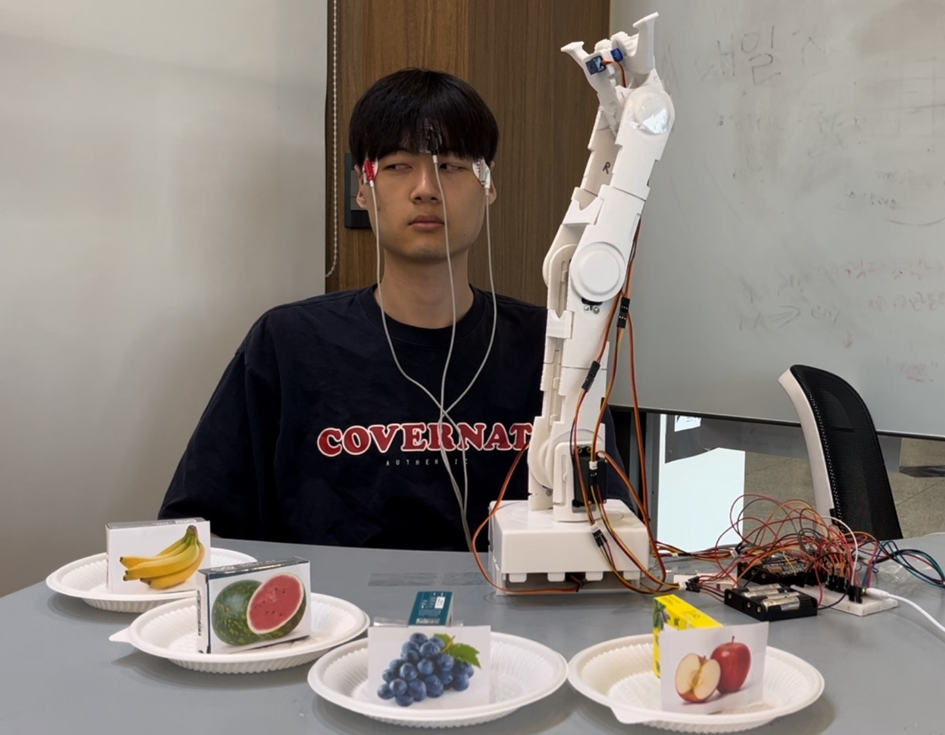
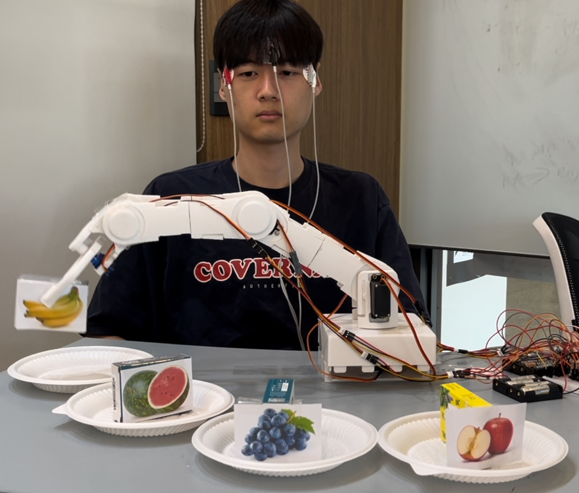
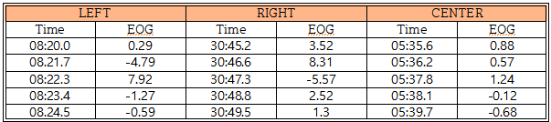

Robotic Arm Control Using Deep Learning-Based Electrooculogram
Ha yeon Yoon, Byeong ho Ahn, Seo Yoon Jung Department of Electronics Engineering, Kyung Hee University
[졸업 프로젝트 발표]
Introduction
Recently, the aging of society has led to limitations in caring for the elderly through human resources. In addition, people with arm movement difficulties need to assist movement.
In this paper, we created robots for people who have difficulty using their arms in meal situations. And our goal is to track the direction of eye movement using only the user’s eye gestures and to pick up food in a specific location instead. For higher accuracy, we create a deep learning model that classifies EOG directions. As a result of training the model using a total of 3000 datasets, the accuracy of test data reached 94.61%.
Therefore, deep learning models can be used to more accurately classify directions into EOG data and freely control robots made of six motors.
Figure 2. 3D modeling
Figure 3. Robot arm
Result
〮 The validation loss of the manufactured model was 0.0392 the validation MAE was 0.0454, and the data accuracy was 92.59%.
〮 By applying a voltage of 5V to the motor in each joint, it acts as a robot arm by moving each joint appropriately.
〮 The angle adjustment can move freely within 180 degrees through repetition of left or right turnovers.
Method
1. EOG Measurement & Analysis
We measure EOG using PSL EOG sensor from Physio Lab, and a total of three electrodes were attached to the left and right sides of both eyes and the center of the forehead.
As a result of EOG measurement, there was no numerical difference when looking at the left and right sides, and the slope of the EOG change was different only at the moment the first movement occurred. So, we used the EOG data change(slope) for the first 5 seconds as the training dataset.
Figure 4. EOG_ model
Figure 1. Left & Right EOG data
Figure 5. How the robot moves
2. EOG Model
Conclusion
Measurements were made for 5 seconds in each direction of the left, right and center and 1000 EOG dataset were collected. And the slope value was obtained by calculating the difference in EOG data at 1-second intervals.
〮 Along with a deep learning model with high accuracy, users can conveniently control the robot with EOG.
〮 The robot can freely pick up food within a 180-degree direction using a total of six motors.
〮 In this paper, the left, right, and center are classified, but in the future, the direction that can be classified is increased.
Table 1. EOG slope dataset for 5 seconds per directions
Reference
The model undergoes 300 epochs of training, processing one sample at a time with a batch size of 1. After each epoch, the validation set is used to evaluate the model's performance.
A Method of EOG Signal Processing to Detect the Direction of Eye Movements Manuel Merino, Octavio Rivera, Isabel Gómez, Alberto Molina
Development of electrooculogram based human computer interface system using deep learning Radwa Reda Hossieny, Manal Tantawi, Howida Shedeed, Mohamed F. Tolba.
ArduinoTensorFlowLiteTutorials/GestureToEmoji (https://github.com/arduino/ArduinoTensorFlowLiteTutorials/tree/master/GestureToEmoji)
AUTODESK Instructables 3D Printed Robot Arm by Beaconsfield ( https://www.instructables.com/3D-Printed-Robot-Arm)
3. Robot arm
For the free movement of the robot arm, we created a robot arm with six degrees of freedom(6DOF) using a motor on the base rotation, shoulder joint, elbow joint, wrist joint, and gripper. The skeleton of the robot arm was made through 3D printing.

